Slide 1
DOS EXPRESS
“The world’s #2 card game”

Slide 2
The Team
Aliza Amir
Nur E Jannat Oishee
Izazul Hoque
Jiali Wu
Jamina Shajrin Diba
SO Pui Na

Slide 3
DOS IS A SEQUEL TO UNO
Is DOS express as fun?

Slide 4
DOS VS.UNO?
As the name suggests, DOS is second to UNO.

Slide 5
Why shouldn’t you play dos express?

Slide 6
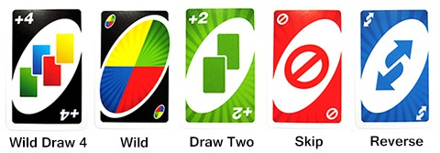
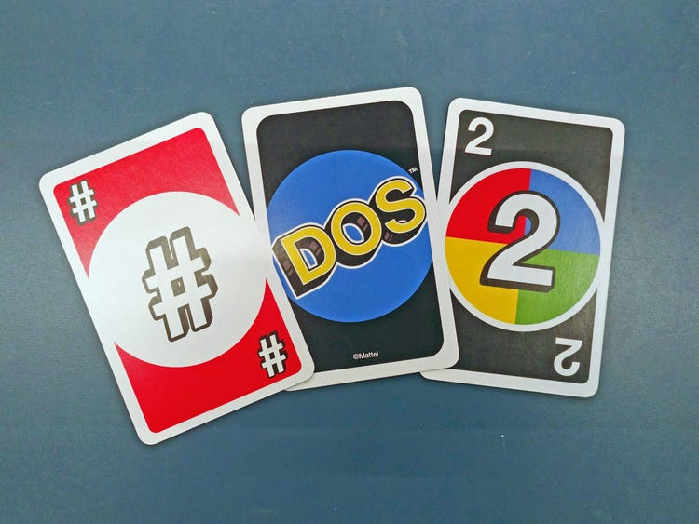
1. NO SPECIAL CARDS
UNO’S SPECIAL CARDS:
DOS’S SPECIAL CARDS:

Slide 7

2.Lengthy

Slide 8
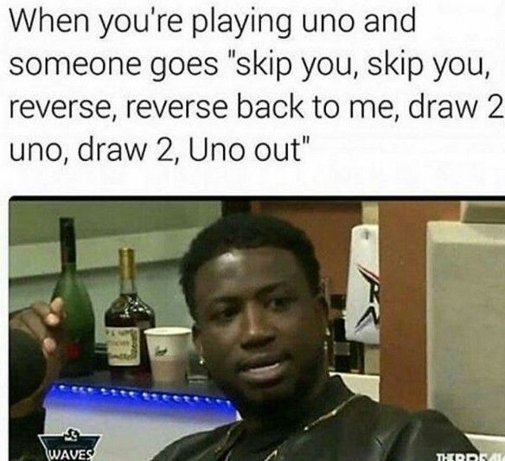
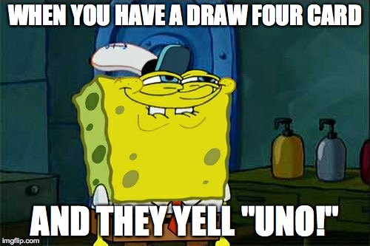
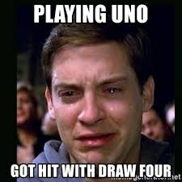
3. Not fun because winning is so easy

Slide 10
45,000,000
Whoa! That’s a big number.

Slide 11
$67,700,000
90,000,000 players
100%
MORE UNO RELATED STATISTICS TO PROVE OUR POINT :
That’s a lot of money
And a lot of people
Total success!

Slide 12
Conclusion

Slide 13
THANKS!
Any questions?

Slide 14
References:
https://www.engadget.com/2019-01-17-uno-mobile-game-ios-android.html
https://mashable.com/article/uno-sequel-dos-card-game/
https://www.insider.com/dos-mattel-uno-card-game-sequel-review-2018-2
https://adage.com/article/cmo-strategy/uno-rose-number/310017

